Slide 1

IMAGE ENCRYPTION
USING TRIPLE DES

Slide 2
ABSTRACT:
In today’s world almost all digital services like internet communication, medical and military imaging systems, multimedia system needs a high level security. There is a need for security level in order to safely store and transmit digital images containing critical information. This is because of the faster growth in multimedia technology, internet and cell phones. Therefore there is a need for image encryption techniques in order to hide images from such attacks. In this system we use Triple DES (Data Encryption Standard) in order to hide image. Such Encryption technique helps to avoid intrusion attacks.

Slide 3
INTRO :
Triple-DES is a process in which we encrypt an image, text or video using 56 bit two keys or 128 bit keys. This kind of process may be secure but still has its flaws. To overcome this flaw we encrypted out file with three 56 bit keys instead of two keys. Hence making it more secure. In the previous referred case study there was only two keys were used for encryption process.
EDE model states that every file or text must be encrypted twice and decrypted once in a sequential order to perform encryption process.
First it encrypts using one secret key and then decrypts using a different secret key finally encrypts using same encrypt key.
So the flaw was if the hacker got to know one secret key it’s very easy to apply brute force attack. Hence to overcome this flaw we are using three different keys for every EDE process
EDE uses 192 bit keys out of which only 168 bits are used for encryption process
Still a very strong algorithm even though we don’t use the last eight bits. Which makes it more secure over a network.

Slide 4
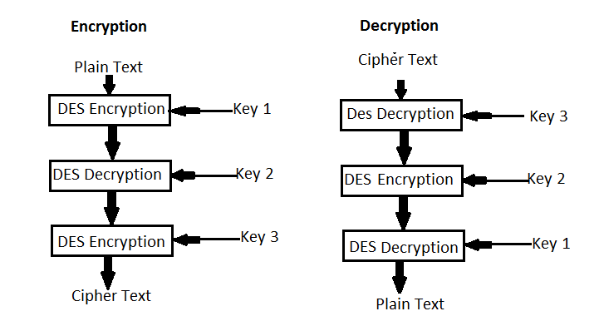
EDE(ENCRYPTION-DECRYPTION-ENCRYPTION)

Slide 5
WORKING:
Triple DES uses total three DES Keys say K₁, K₂ and K₃, each of 56 bits.
This does not include parity bits.
The encryption algorithm is:
CipherText= E_{K3}(D_{K2}(E_{K1}(plaintext)))
I.e., DES encrypt with K₁, DES decrypt with K₂, then DES encrypt with K₃.
Decryption is the reverse:
Plain Text = D_{K1}(E_{K2}(D_{K3}(CipherText)))
I.e., decrypt with K₃, encrypt with K₂, then decrypt with K₁.

Slide 6

Modules used :
DES
SHA256
GETPASS
PBKDF2
CRYPTO

Slide 7


CONCEPT
ORIGINAL IMAGE ENCRYPTED IMAGE(CAN’T OPEN) DECRYPTED IMAGE

Slide 8

Thank You
AMAR T

